Slide 1

Community Infrastructure Levy

Slide 2
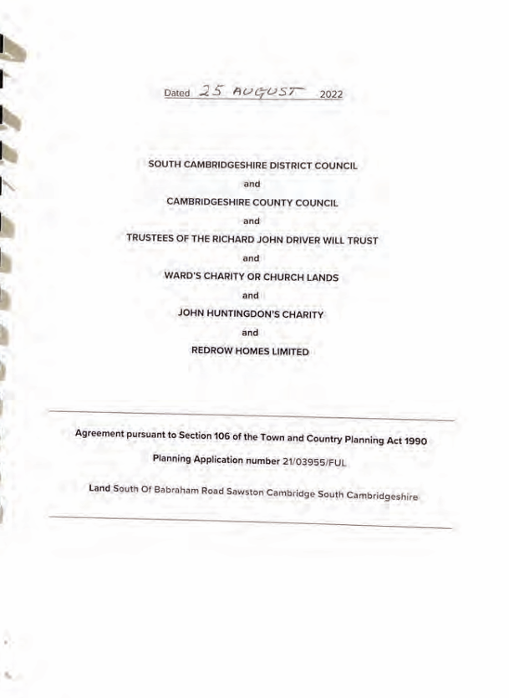
Section 106 agreements:
Legal agreements securing covenants to mitigate the impact of a development
Only major development are required to pay contributions
Negotiable on a site-by-site basis and subject to viability
Ring fenced contribution providing confidence to the community
Payment dates agreed in the deed depending on need and developer cashflow
Funds to be returned to developer if unspent after 10 years of receipts
Can take months to complete and difficult to amend
The following contributions will still be sought for a parish via a s106 agreement:
community facilities, outdoor sports, children's play space, allotments and orchard space, green infrastructure
In addition, indoor sports and swimming and where required education

Slide 3
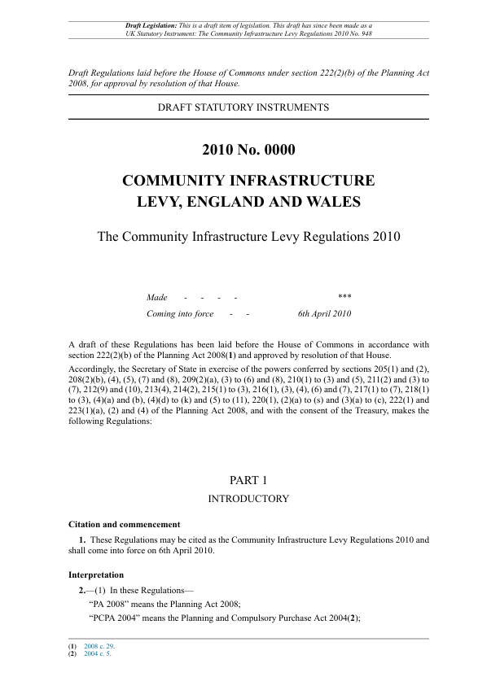
Community infrastructure Levy:
Financial payments only
Charged on all developments (referenced in the charging schedule)
Non-negotiable and not subject to viability
CIL funds infrastructure across a wider area
Payment dates based on published instalment policy
CIL funds are not returned to developer (but can be to SCDC from PC after 5 years)
Do not delay the grant of planning permission
Exemptions? Affordable housing, self-build, charitable development, residential annexes

Slide 4
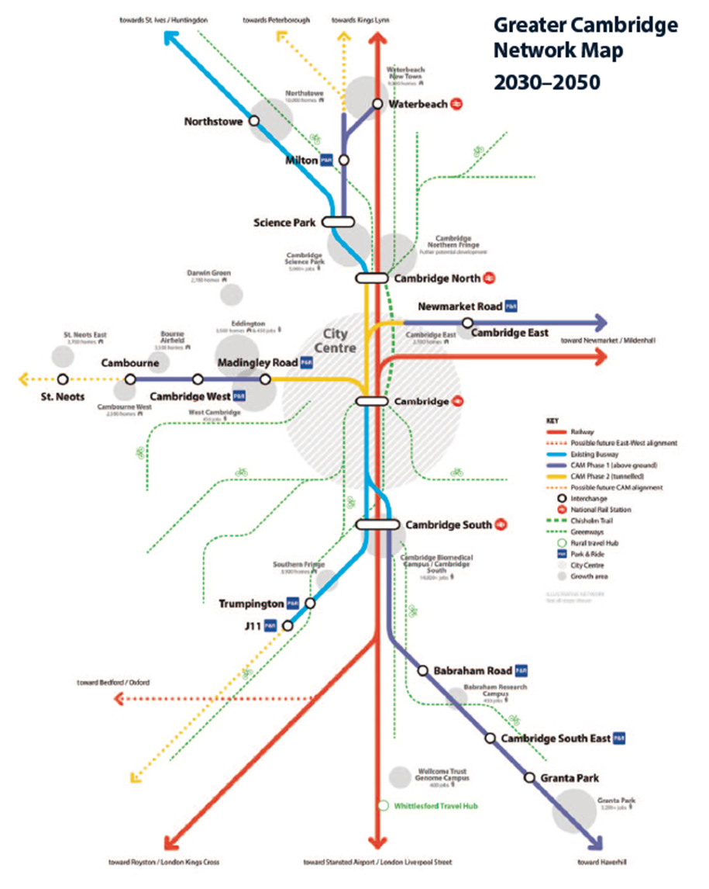
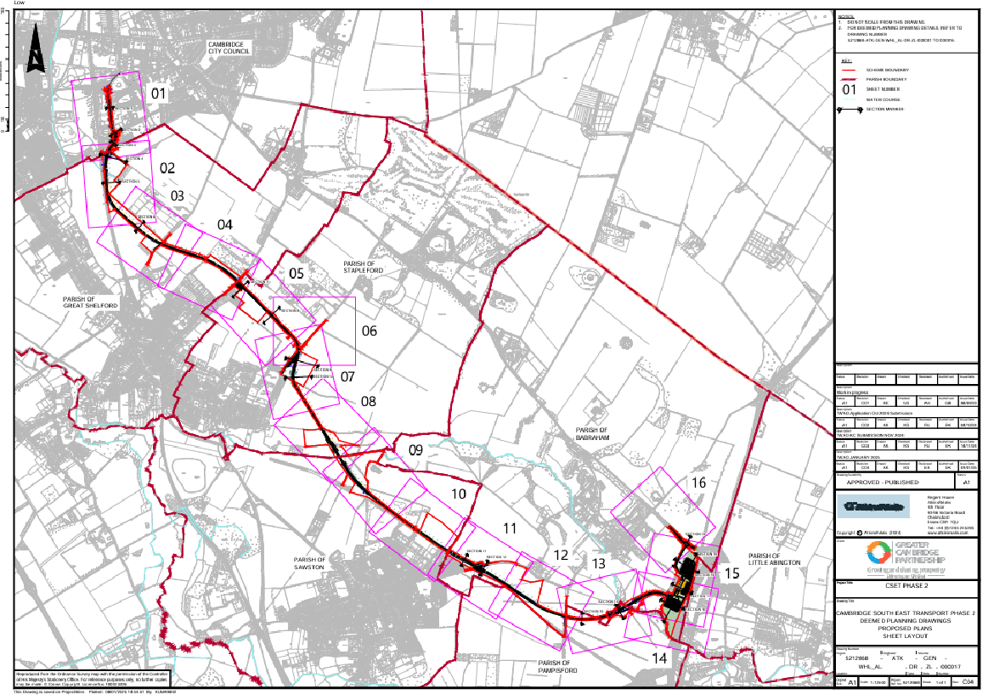
Why we are looking to introduce a CIL

Slide 5
Infrastructure Statement identifies:
Infrastructure needs
Total cost of infrastructure
Anticipated funding from developer contributions
Sources of funding
Viability:
Proportionate, simple, transparent
Area-based approach, involving a broad test of viability across their area
Reasonable, given the available evidence
No requirement for a proposed rate to exactly mirror the evidence
Should include a ‘buffer’ or margin is included, so that the levy rate is able to support development when economic circumstances adjust

Slide 6
The Draft Charging Schedule
Levy Rates
Specifies types of development

Slide 7
What rates are the Council’s proposing
Draft Charging Schedule
Industrial Buildings, Storage Buildings, Data Centres | £35 per sqm
Shops, Restaurants, Cafes, Financial Institutions, Hotels | £50 per sqm
Houses, Retirement Homes, Student Accommodation | £60 per sqm
Offices and Lab Space | £175 per sqm

Slide 8
The instalment policy proposed being used by South Cambridgeshire District Council is:
 |  | Days After Commencement
Total CIL Liability |  | 120 | 240 | 360 | 420
£0 | £49,999 | 100% | - | - | -
£50,000 | £249,000 | 50% | 50% | - | -
£250,000 | £499,999 | 25% | 50% | 25% | -
£500,000+ |  | 25% | 25% | 25% | 25%

Slide 9
How will CIL interact with S106 Agreements?
Benefits of CIL to Parish Councils
Direct control over Neighbourhood Proportion (15% - 25% where a Neighbourhood Plan is adopted)
Parishes can influence what facilities are funded in their area using the Neighbourhood Proportion
CIL money can be pooled towards one project rather than split into different types of spend
Can combine and match fund when delivering larger projects
The Parish Council must use the CIL receipts passed to it to support the development of the parish council’s area by funding the provision, improvement, replacement, operation or maintenance of infrastructure; or anything else that is concerned with addressing the demands that development places on the area.

Slide 10
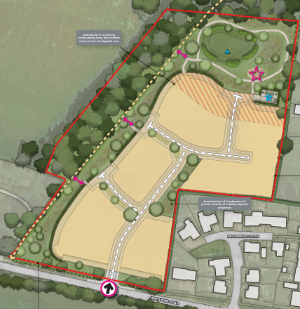
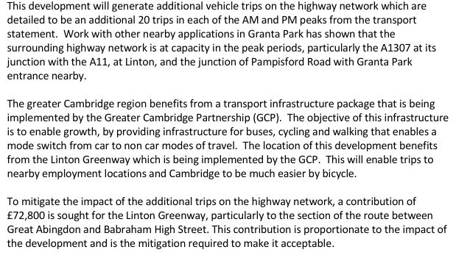
CIL = £100k: Transport £80k Neighbourhood portion = £15K. Admin £5k.

Slide 11
6-week consultation 16 February to 29 March
Representations analysed
Examination in public
Examiners report
Full Councils
Implementation (possibly 1 January 2027)
the charging authority has complied with the legislative requirements set out in the Planning Act 2008 and the Community Infrastructure Levy Regulations
the draft charging schedule is supported by background documents containing appropriate available evidence;
the charging authority has undertaken an appropriate level of consultation;
the proposed rate or rates are informed by, and consistent with, the evidence on viability across the charging authority’s area; and
evidence has been provided that shows the proposed rate or rates would not undermine the deliverability of the plan

Slide 12
QUESTIONS

